Slide 1
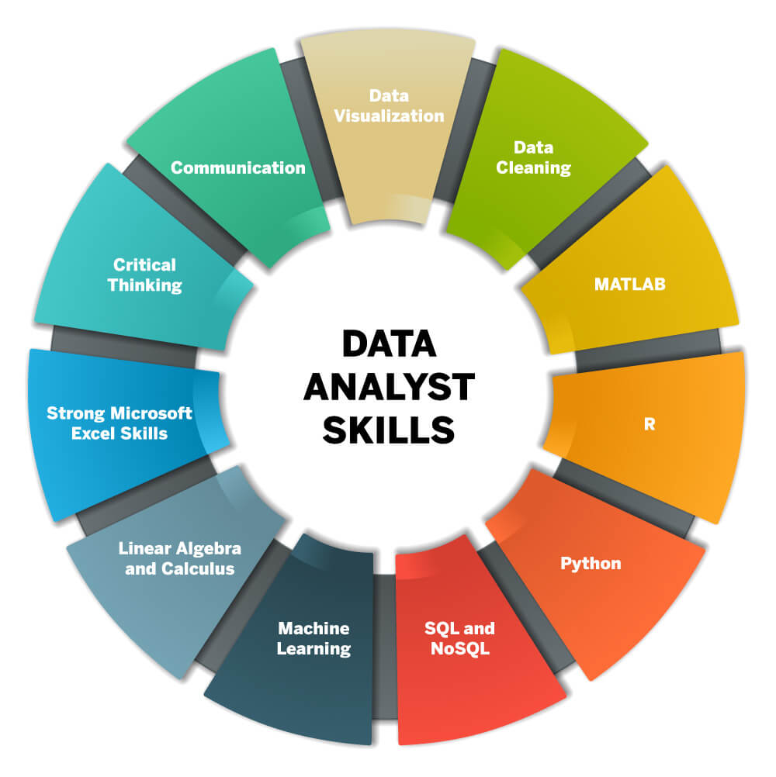
Alankar C. Dhumal (B.Engg., MBA, APMP) Data Analytics Portfolio

Slide 2







Skills
My Skills

Slide 3
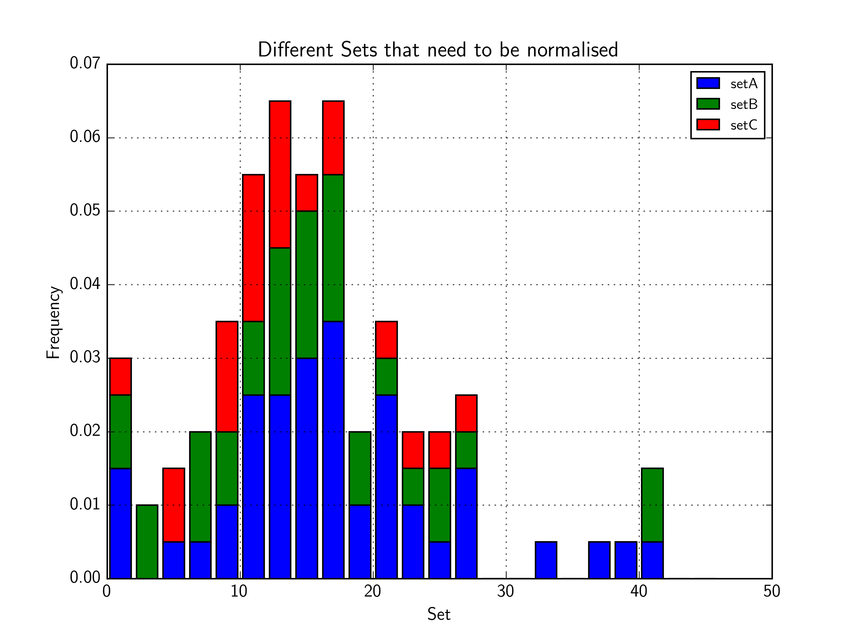
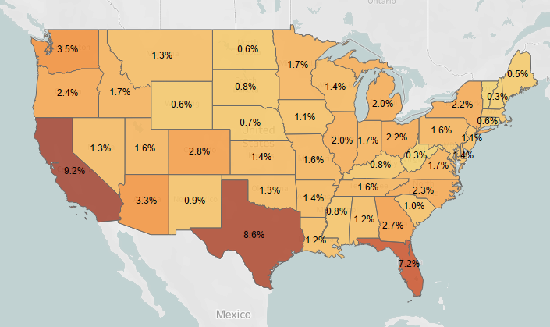
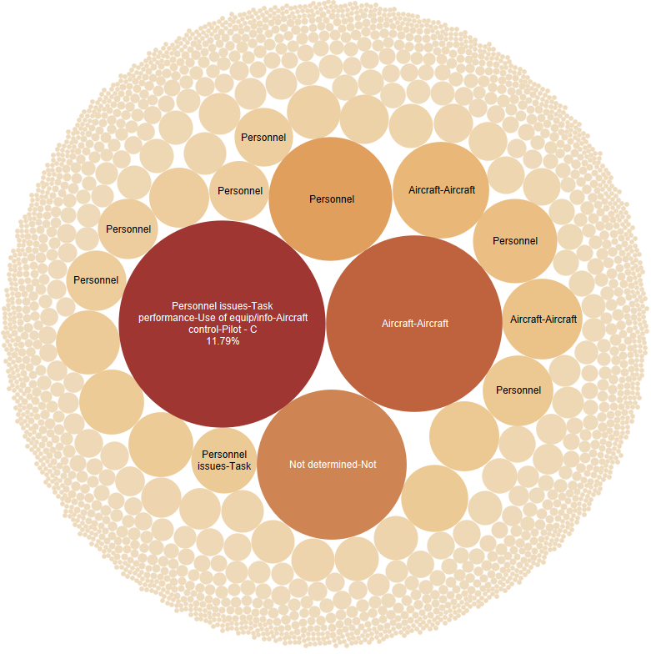
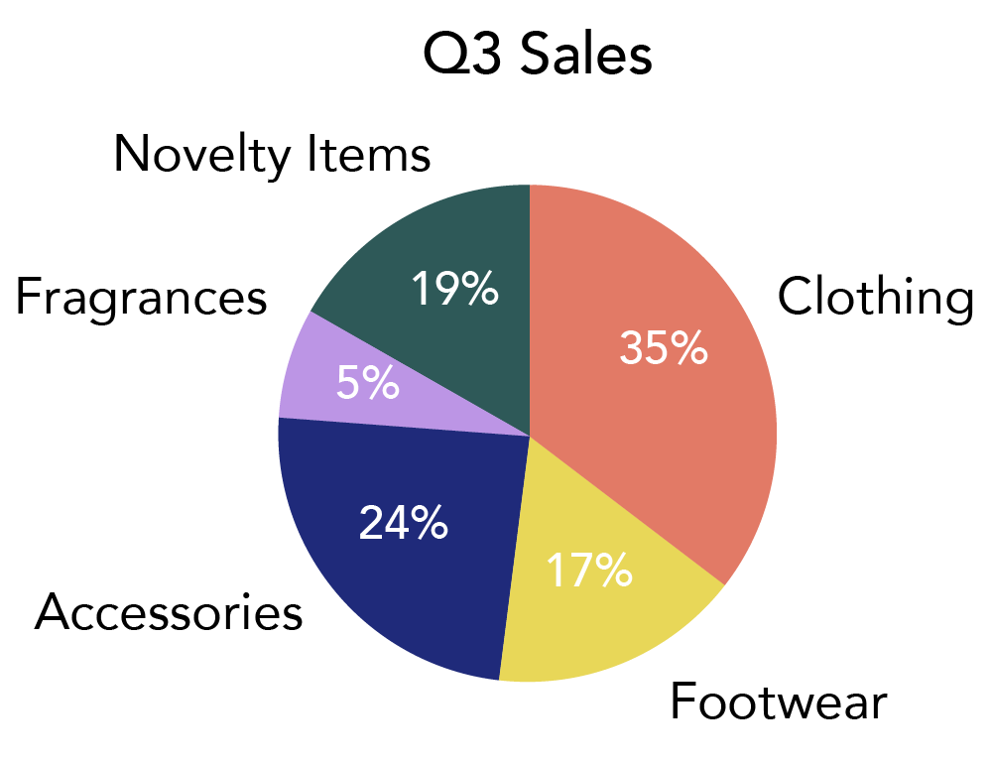
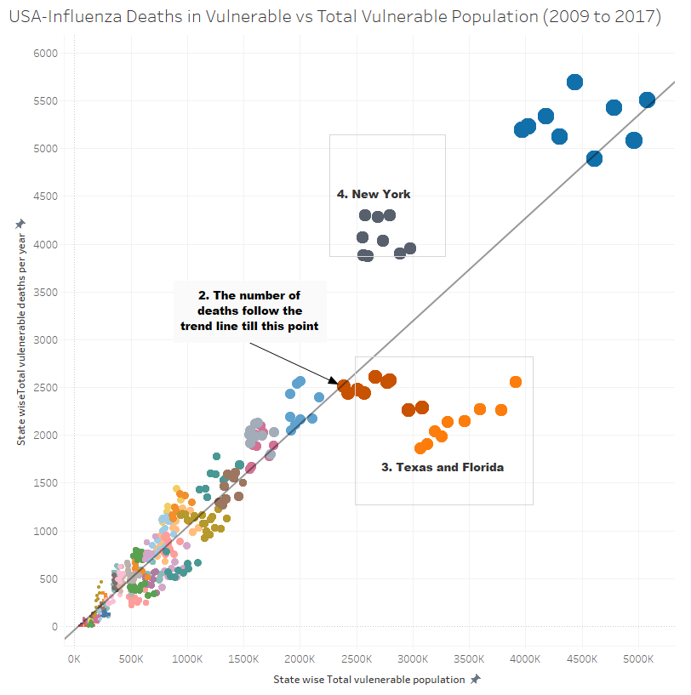
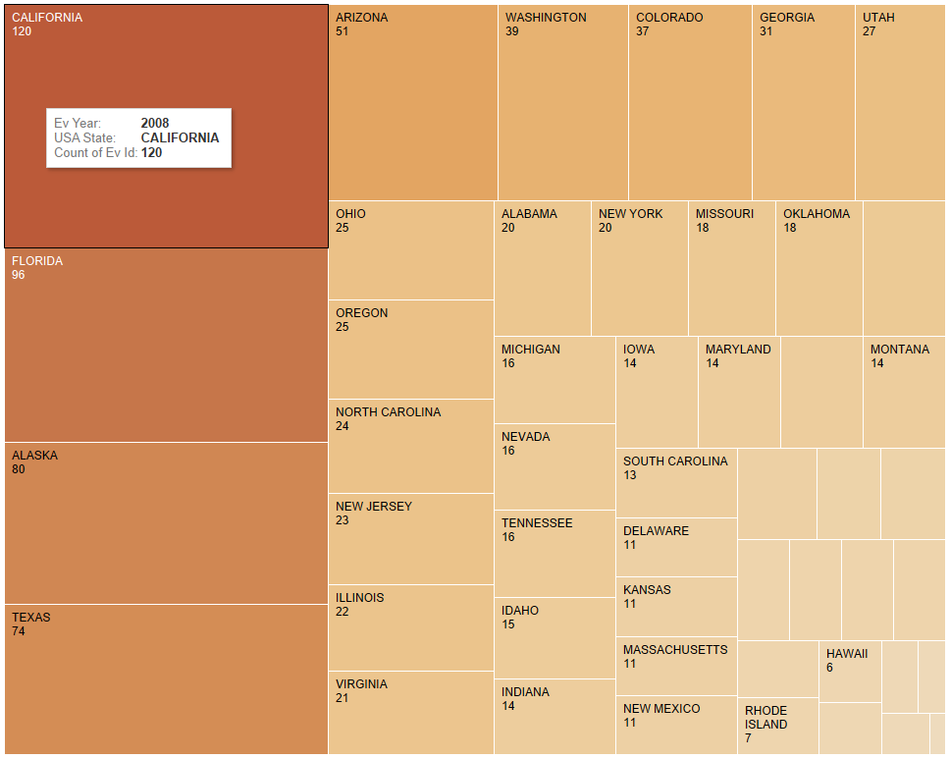
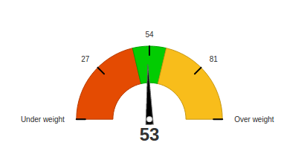
Visualization Skills
Histograms
Spatial Charts
Visualization Skills
Pie charts
Packed Bubbles
Tree Maps
Scatter Plots
Custom Visualizations Using Excel

Slide 4
Project Portfolio
1
2
3
4
5
GameCo- Marketing Analysis
Influenza Season-
Medical Staff Planning
Customers base Analysis
Customers Profiling and Analysis
USA-Aircrafts Accidents Analysis
Client:
Video Game Company
Task:
Identifying market opportunities for launching new video games
Client :
Supplier of Temporary Medical Staff
Task :
Analysing the USA Influenza Season and preparing a staffing plan staff
Client :
DVD Renting company
Task :
Analysing customer base and preferences,
Client:
Online Grocery Store
Task:
Gain market insights based on customer profiling
Independent Study Project
Task:
Gain insights into the air accidents in the USA by analysing NTSB’s accidents database
Analysis Tools :
MS Excel
Analysis Tools :
MS Excel
Tableau
Analysis Tools :
PostGre SQL
MS Excel
Tableau
Analysis Tools :
Python
MS Excel
Analysis Tools :
Python
MS Excel
Tableau

Slide 5

GameCo Marketing Analysis
Portfolio Project-1
Presented by : Alankar Dhumal-Data Analytics Team

Slide 6



GameCo Marketing Analysis
Who is the client?
GameCo is a new video game company who wants to launch its video games worldwide
What is the Objective?
Analyse the global video game market for regional sales, genres, platforms and competition
What are the datasets ?
Link to Dataset
It tracks the total number of units of games sold (not financial figures) from 1980 to 2016.
The numbers represent units sold in millions. When you see the number “1.2,”for instance, this represents a total of 1.2 million units sold.

Slide 7
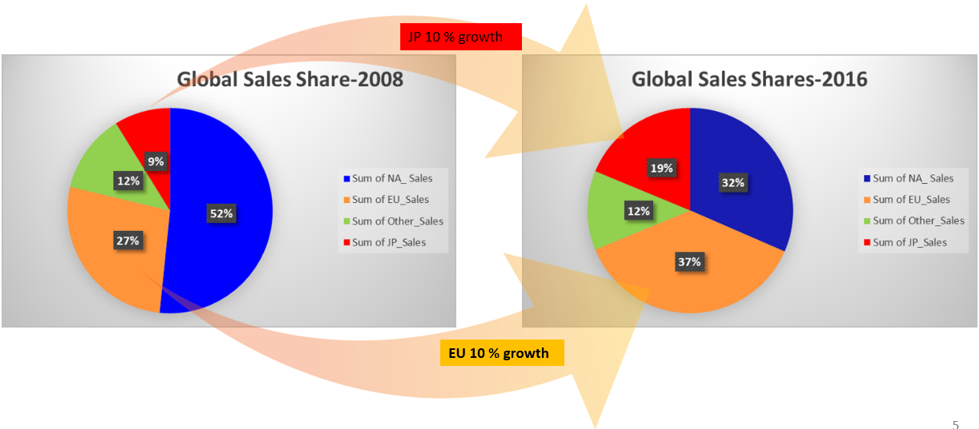
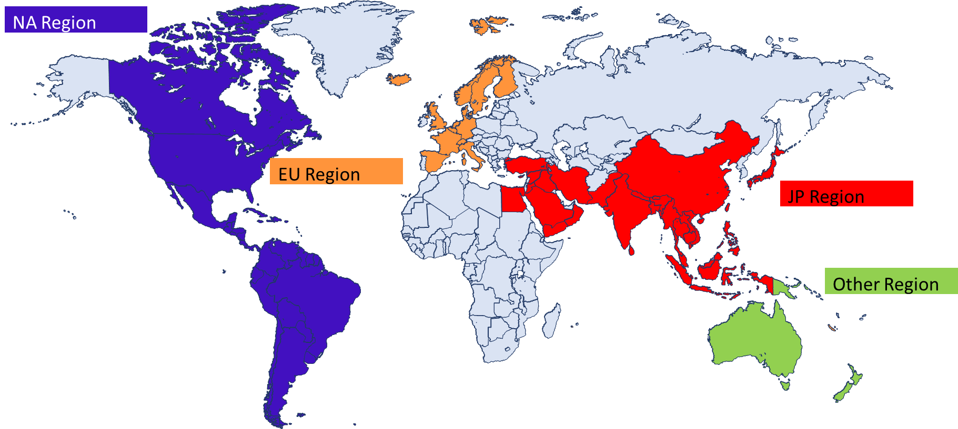
GameCo Marketing Analysis
Regions
Sales Share

Slide 8
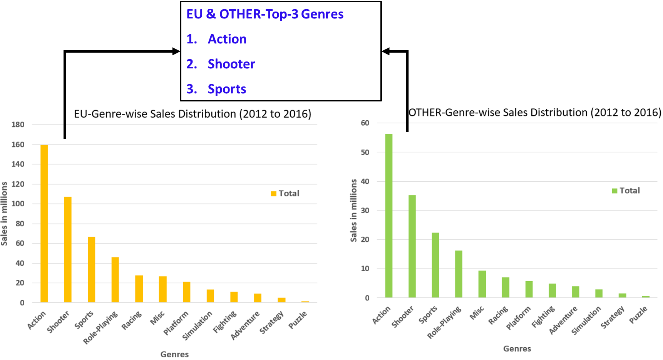
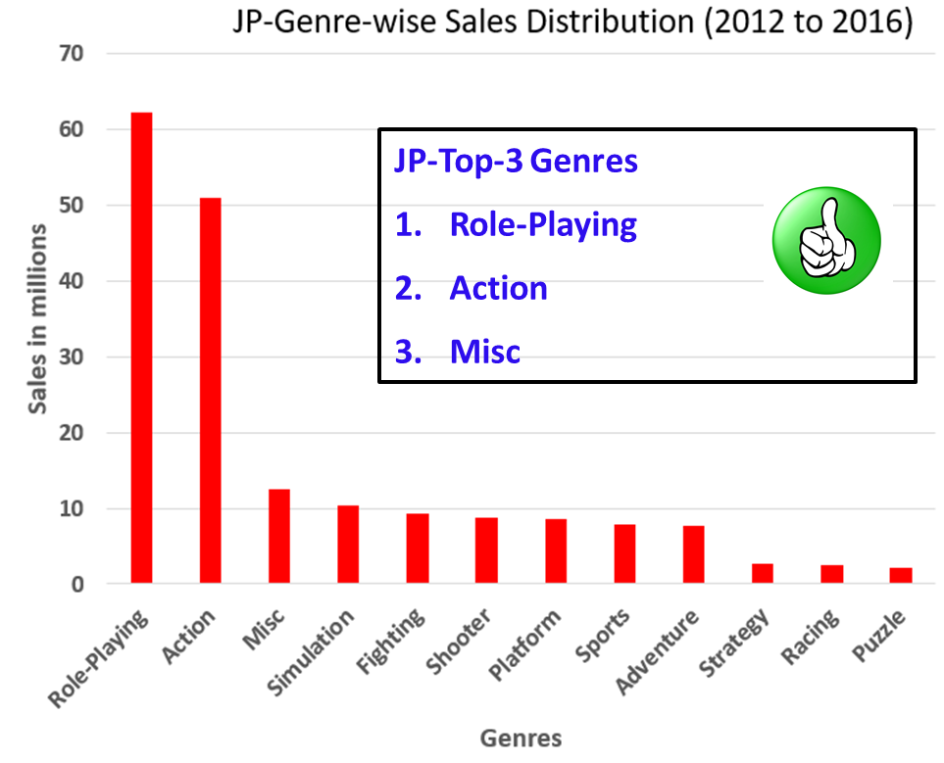
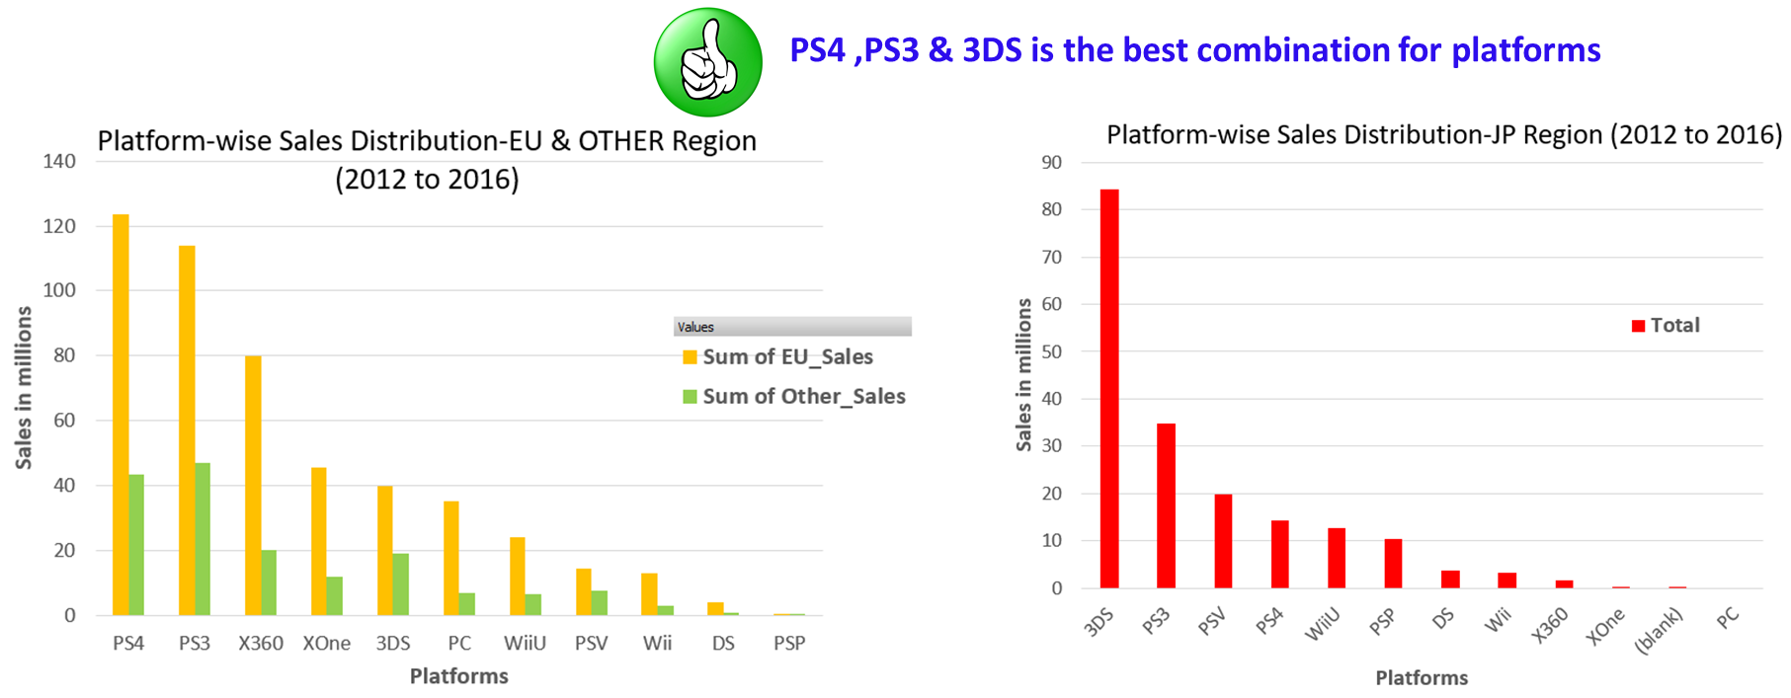
Region-wise Genres
Best Genres:
EU & OTHER region :
“Action”
“Shooter”
JP region :
“Role-playing” “Action”
Best Platforms:
PS4,PS3,3DS

Slide 9

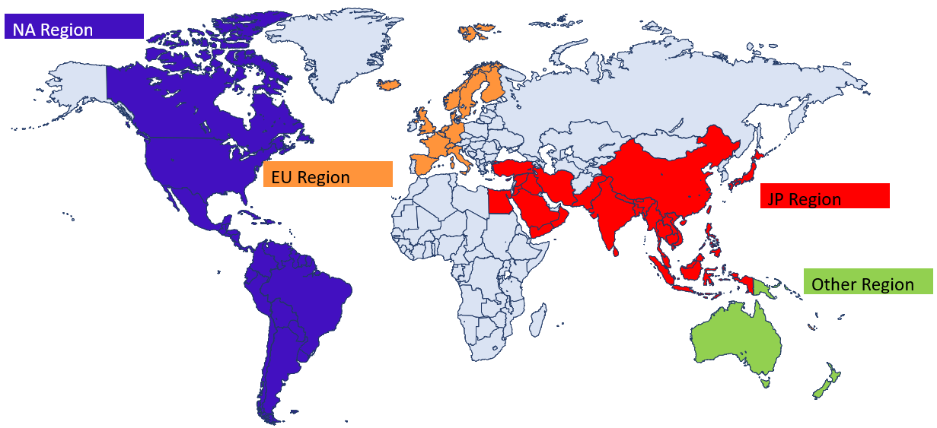
Recommendations
No marketing budget to be allocated to NA region without fully analyzing what has caused the steep decline in sales.
Marketing resources to be allocated to 3DS & PS3 platform based “Role-playing” & “Action” games with special focus on 3DS based “Role-playing” games
Marketing resources to be allocated to PS4 & PS3 platform based “Action” & “Shooter” games
Marketing resources to be allocated to PS4 & PS3 platform based “Action” & “Shooter” games

Slide 10


Links to Presentations and References
PowerPoint Presentation

Slide 11

Influenza Season Temporary Staff Planning (2017-18)
Portfolio Project-2
Presented by : Alankar Dhumal Data Analytics Team

Slide 12
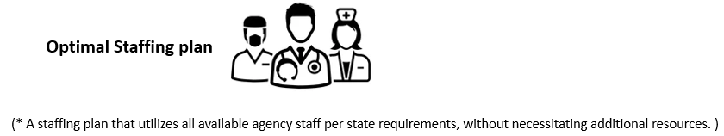
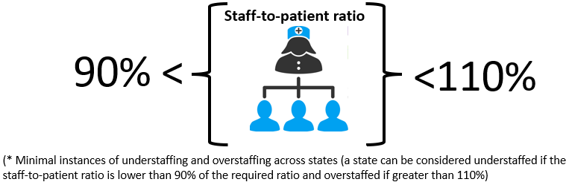
Influenza Season Temporary Staff Planning
Who is the client?
Medical staffing agency in the USA that provides temporary workers to clinics
and hospitals on an as-needed basis
What are the datasets ?
Influenza deaths by geography, time, age, and gender
Link to Dataset
Population data by geography
Link to Dataset

Slide 13
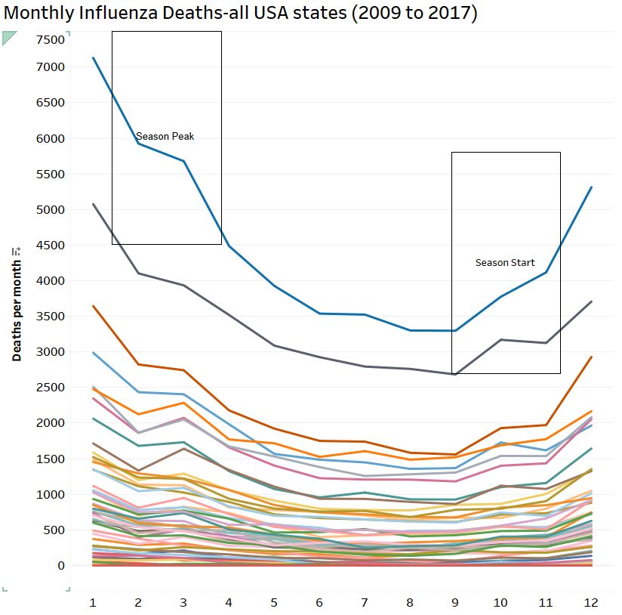
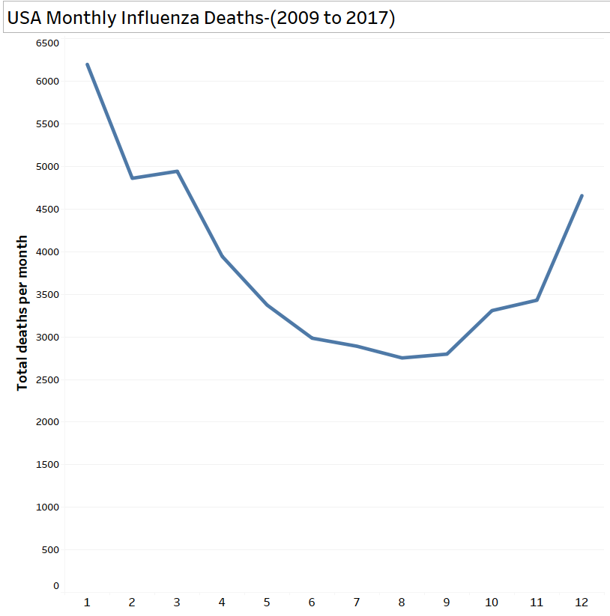
Influenza Season In the USA
Monthly Influenza Deaths-Individual States
Monthly Influenza Deaths- Entire Country
Season peak-January
Season start-
July, August

Slide 14
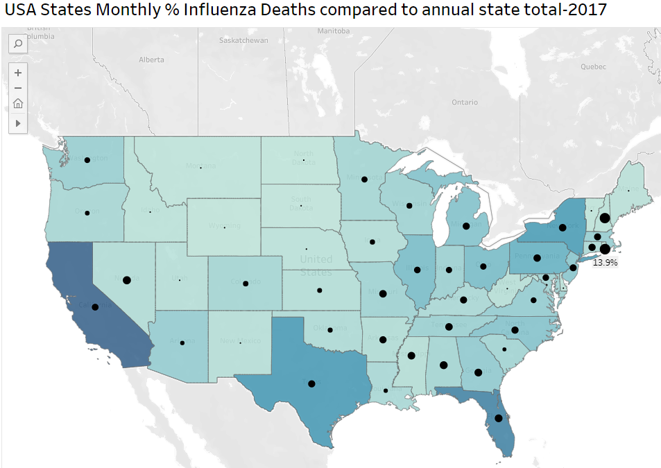
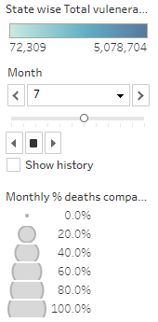
Influenza Season Propagation-Interactive Chart
link to the detailed Tableau chart
After clicking the link,
change the months here to see the influenza deaths for that month
Darker shades show more vulnerable population

Slide 15
Relationship between Influenza Deaths and Vulnerable Population
link to the detailed chart

Slide 16
Staffing Priority
Priority-01
Month of the season- states where season is peaking will be prioritized
Priority-02
States with more vulnerable population and annual deaths above trend line
Priority-03
More % monthly deaths as compared to others

Slide 17
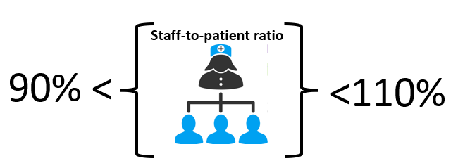



Project Success Measurement
Will be measured in association with the Agency and hospital data tracking teams. Frequency to be agreed
VS
Additional Staff requisitions raised by hospitals then planned
(No requisitions will mean the planning is optimal)
Planned
Required
Average or below average patient wait times
Satisfaction Surveys – Patients, Hospital Permanent Staff, Agency Staff

Slide 18


Links to Presentations and References
PowerPoint Presentation
Storyboard prepared for Public Awareness
Spatial Visualization
Bubble Plot
Video Presentation To the Client

Slide 19
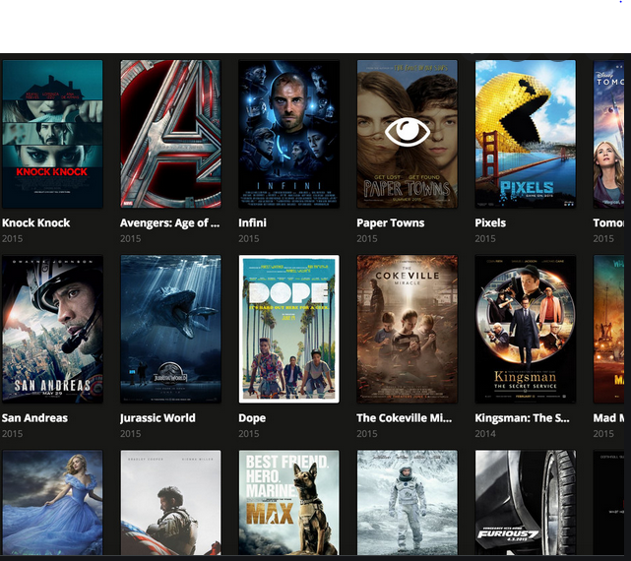

Quarterly Business Insights
Portfolio Project-3
Rockbuster Stealth
Presented by : Alankar Dhumal
Data Analytics Team

Slide 20
Rockbuster Stealth Customer base Analysis
Who is the client?
Rockbuster Stealth LLC is a movie rental company that used to have stores around the
World. But Facing stiff competition from streaming services such as Netflix and Amazon Prime, now planning to use its existing movie licenses to launch an online video rental service in order to stay competitive.
What is the Objective?
Analyse global customer base and provide recommendations
What are the datasets ?
Rockbuster Stealth Database
Database Download link

Slide 21
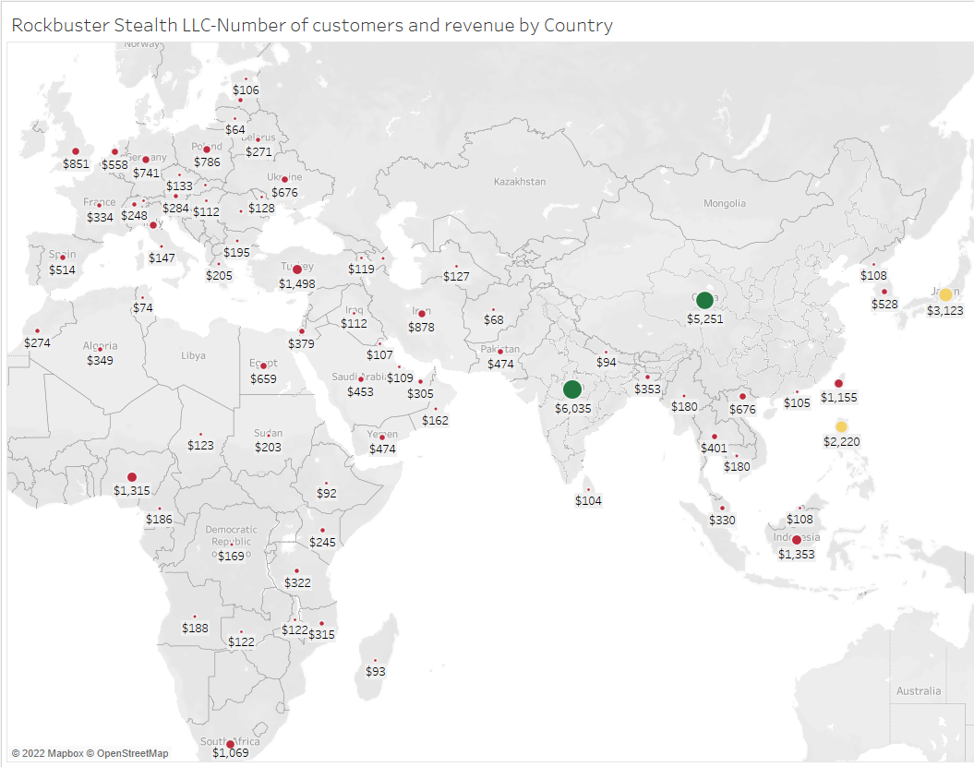
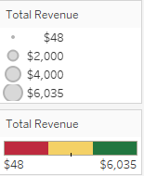
Rockbuster Stealth Global Revenue Map
link to the detailed chart

Slide 22
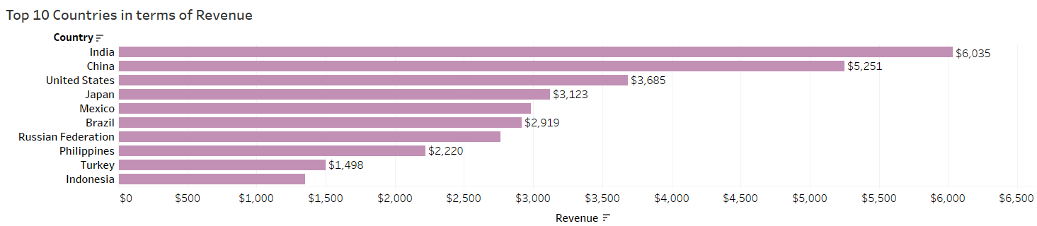
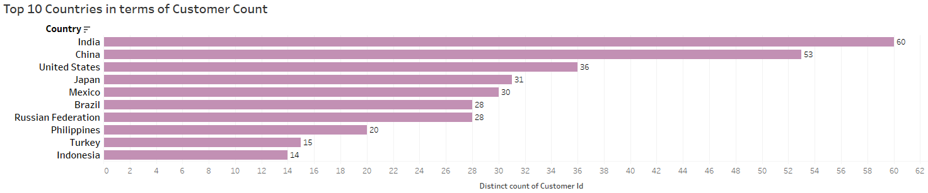
Rockbuster Stealth Customer Base-Top 10 Countries
Top Countries- Revenue
Top Countries- Customer Count

Slide 23
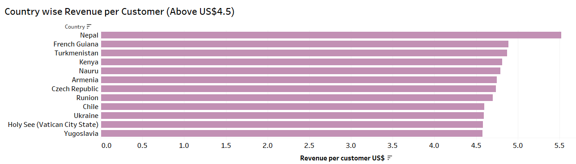
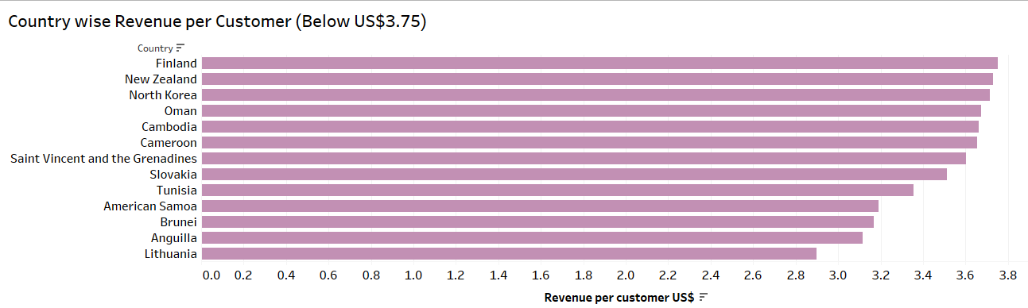
Recommendations
Top Countries- Revenue per Customer > US$4.5
Introduce more content in local language
Introduce more titles with local language sub-titles
Top Countries- Revenue per Customer < US$3.75
Survey the market for customer feedback
Introduce promotions
Further research the market

Slide 24
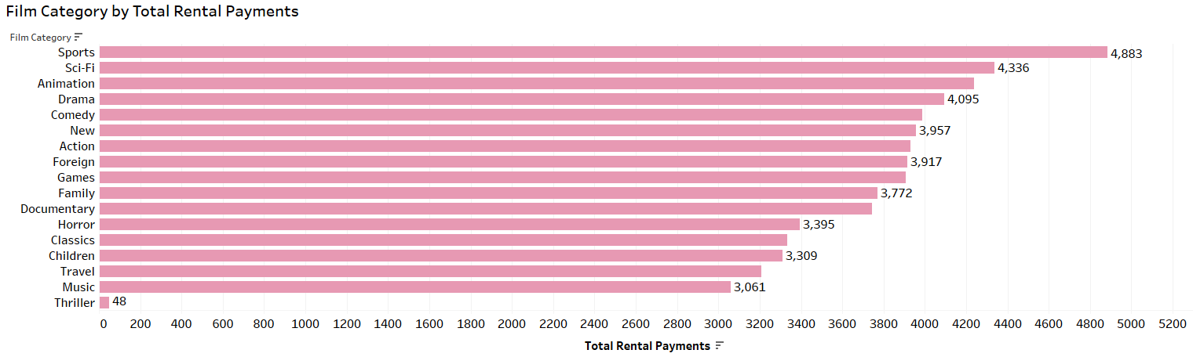
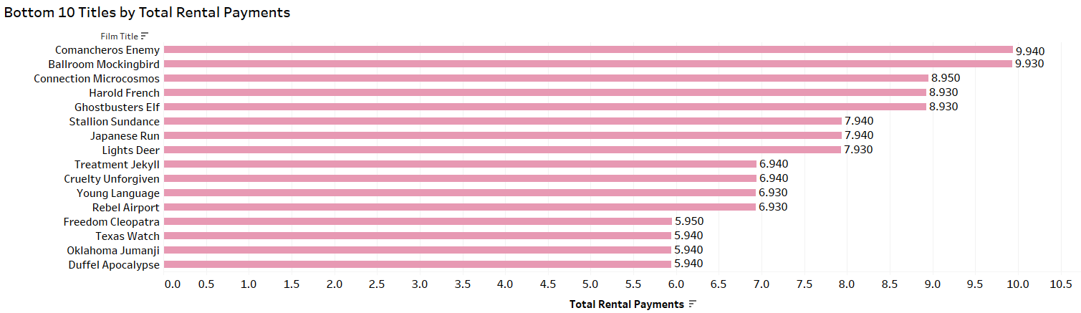
Content Recommendations
Film Categories : Total Rental Payments
Reconsider licensing the current movies in Thriller Category
Film Titles : Total Rental Payments
Reconsider licensing all of these movies

Slide 25
Links to Presentations and References
PowerPoint Presentation
All SQL Queries
Spatial Visualization

Slide 26

Portfolio Project-4
Customer Profiling
Presented by : Alankar Dhumal
Data Analytics Team

Slide 27
Instacart Customer Profiling and Analysis
Who is the client?
Instacart is an online grocery store based in the USA that operates through an app
What is the Objective?
Create customer profiles based on buying behaviour and demographics and analyse it to gain insights for marketing and sales teams
What are the datasets ?
Instacart Dataset
Download Link

Slide 28






Customer Profiles
Middle Class Family
Age
Income
Marital Status
Senior Single
Kids?
Age
Young Family
Income
Marital Status
x
Age
Kids?
Income
Marital Status
Kids?
Young Single
Wealthy Family
Age
Income
Age
Marital Status
Income
Kids?
Marital Status
Kids?

Slide 29
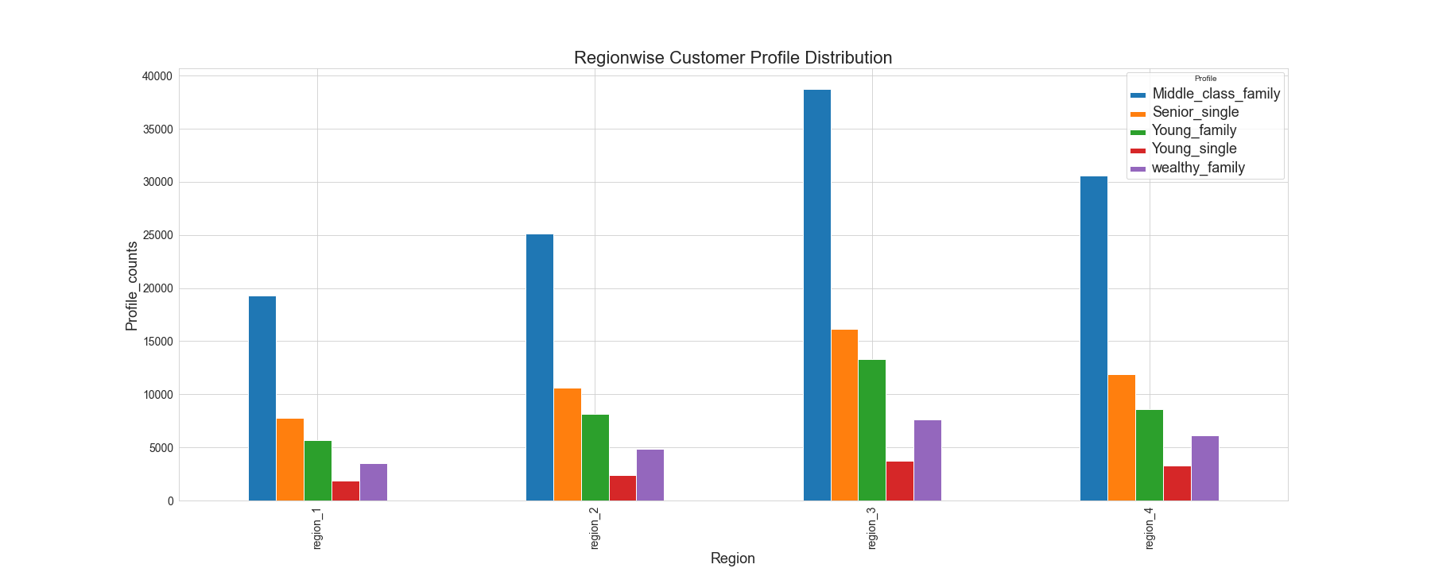
Customer Profiles-Region wise Distribution

Slide 30
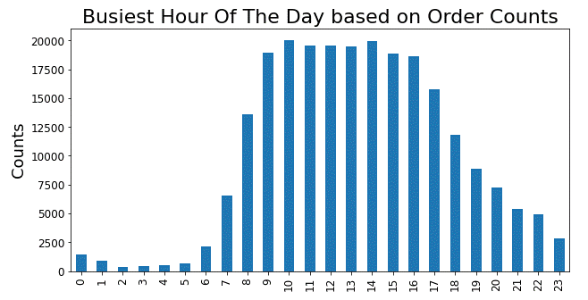
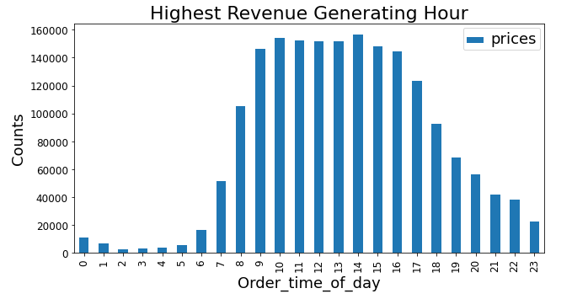
Busiest Order Periods
Busiest Hours based on Order Counts
Busiest Hours based on Revenue

Slide 31
Links to Presentations and References
All Python Scripts
Data Preparation and Visualization Log

Slide 32

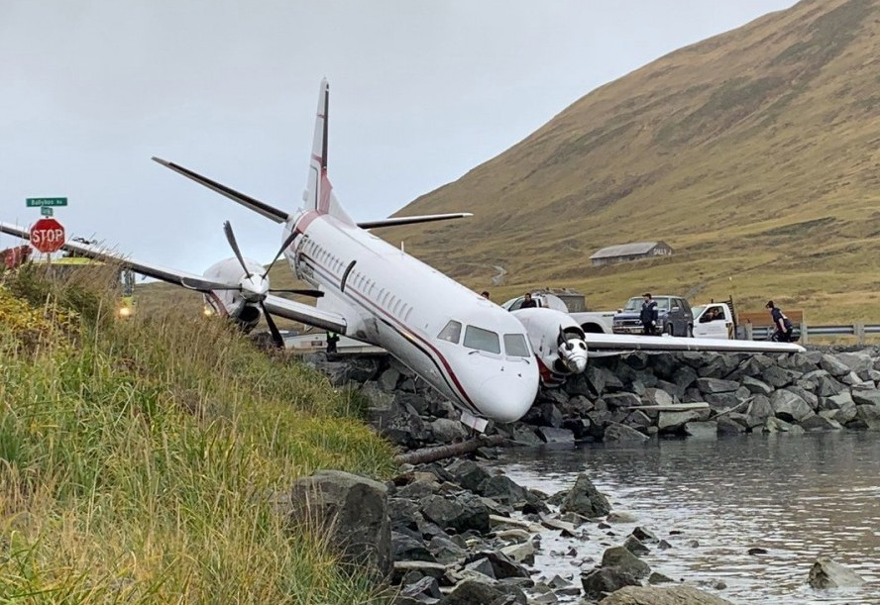
Portfolio Project-5
Aircraft Accidents in the USA- Insights
Presented by : Alankar Dhumal

Slide 33
Aircraft Accidents in the USA- Insights
Who is the client?
This is an independent analysis conducted out of personal interest
What are the objectives
1. What is the Yearly Trend of number of aircraft accidents?
2. Which States report the maximum aircraft accidents
3. Which periods (months, day, time of the day) have maximum aircraft accidents
4. Which Aircrafts of which manufacturers are involved in maximum aircraft accidents
5. Is bad weather a factor ?
6. Is there a relationship between number of seats and number of injuries, fatalities?
7. What are the major contributing factors to the accidents identified by NTSB ?
What are the datasets ?
This is an internal administrative database owned by NTSB which is publicly available below at https://data.ntsb.gov/avdata

Slide 34
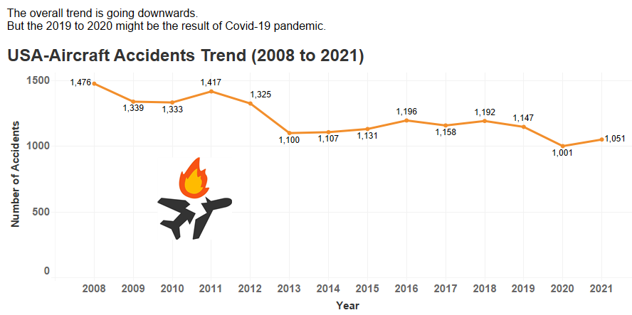
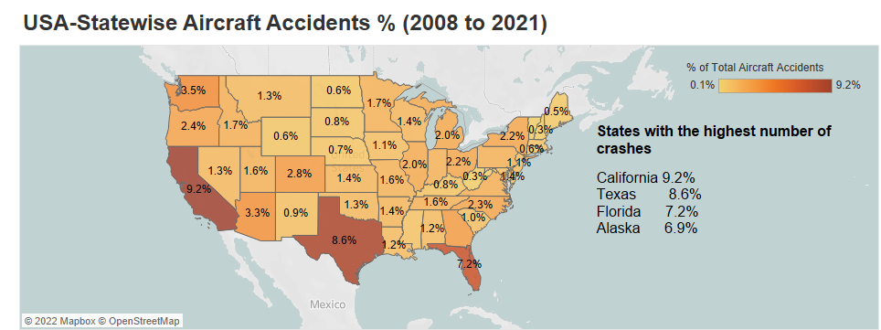
Aircraft Accidents Trend In The USA

Slide 35
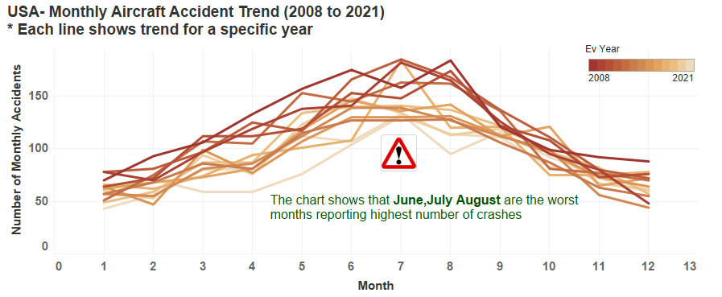
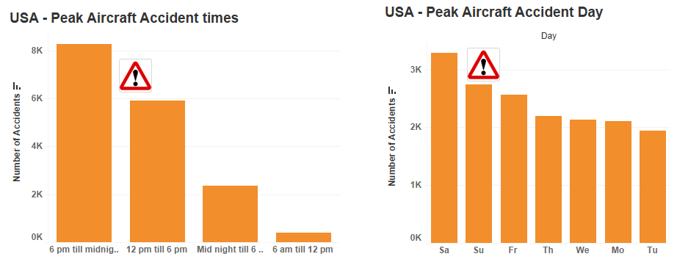
Peak Month, Time And Day For Aircraft Accidents

Slide 36
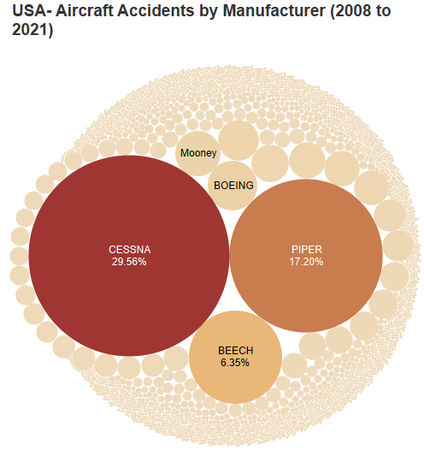


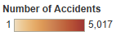
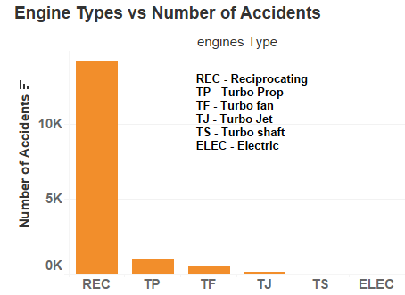
Make Of The Aircrafts Involved In Aircraft Accidents

Slide 37
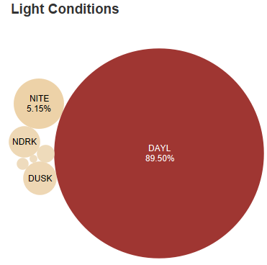
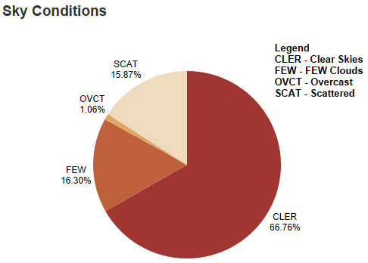
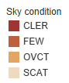
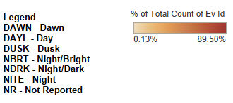
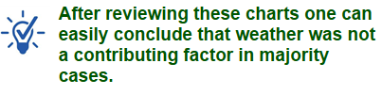
Role Of Weather In The Aircraft Accidents

Slide 38
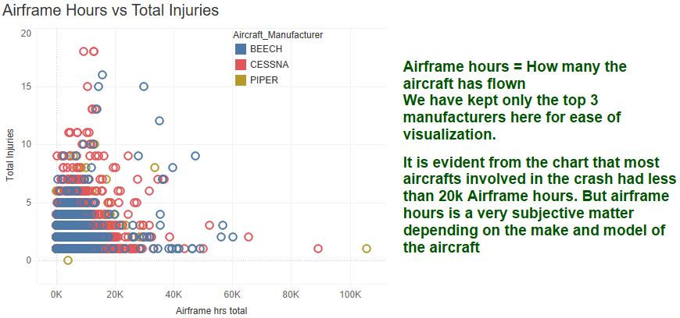
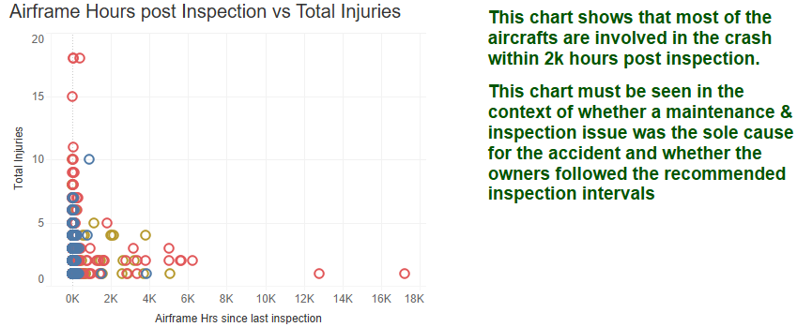
Hours Of Flight And Hours Post Inspection Before Aircraft Accidents

Slide 39
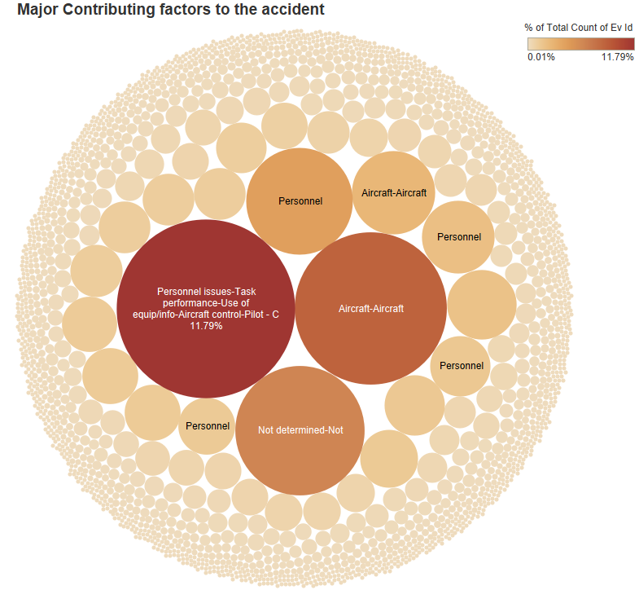
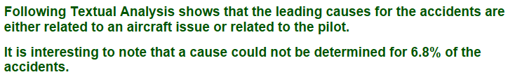
Major Contributing Factors

Slide 40
Summary And Conclusion
Summary
The aircraft accident trend is generally downwards but it must be analyzed in the context of total flight volume.
The number of accidents should be converted to a % of the total aircrafts took flight during the period under consideration.
Same goes with the states with max air accidents.
This number needs to be converted to a % of total flights took off from that state during the period under consideration.
This is also appliable to the top manufactures on the accidents list. Their numbers must be seen as a % of how many aircrafts that have been sold.
Even though reciprocating engines are involved in most of the accidents, engine failure may not be the sole cause for the accident
The database has two tables namely "Events_Sequence" and "Findings". These have more details about the multiple events leading to the accident. These must be further analyzed to segregate specific causes such as equipment malfunctions, human errors, procedural issues etc. related to each accident so that every chart in this story will gain some context.
Conclusion
We can certainly draw some broad conclusion here.
1. Most of the aircraft accidents over the weekend
2. June, July, August are the months reporting maximum accidents
3. Most crashes took place between 12 pm to midnight
4. Smaller aircrafts (<25 seats) are more likely to crash

Slide 41
Links To Presentations And References
All Python Scripts
Detailed Storyboard prepared for General Public

Slide 42




My Contact Info
alankar.dhumal@gmail.com
https://www.linkedin.com/in/alankar-dhumal-a03133aa
https://github.com/Alankar2299
https://public.tableau.com/app/profile/alankar2299

